Slide 1

EECE 7244 Microelectromechanical Systems
AI-Enhanced MEMS Drug Delivery Catheter
SATHWIK CHOWDARY MERLA
TIRTH PATEL
YASHWANTH RAGHAVENDRA MUPPANEN

Slide 2
Current Challenges in Cancer Treatment
Systemic Chemotherapy Limitations
Severe systemic toxicity - whole body exposure
Dose-limiting side effects - nausea, hair loss, organ damage
Poor tumor penetration - especially brain tumors
Drug resistance - cancer cells develop resistance
Non-specific delivery - affects healthy cells
MEMS Solution
Localized delivery - directly to tumor site
Reduced systemic exposure - minimize side effects
Higher local concentrations - improved efficacy
Programmable dosing - temporal control
Refillable system - chronic therapy capable

Slide 3
Device Architecture & Components
Component | Material | Key Specifications | Function
Bellows Actuator | Parylene C (10 μm) | 2 convolutions, 50-100 μL volume | Electrolysis-driven expansion
Electrodes | Pt/Ti bilayer | 200/50 nm, interdigitated | Water electrolysis catalyst
Membrane | Parylene C (5 μm) | 50 mm² area | Electrode substrate
Reservoir | Silicone rubber | 100-300 μL capacity | Drug storage
Check Valve | MEMS/Spring-loaded | <10 kPa cracking pressure | Prevent backflow
Catheter | Silicone tubing | ID 0.3-0.5 mm, 10-30 mm length | Drug delivery to tumor

Slide 4
Fabrication Process (Electrode Base)
Step 1: Silicon Wafer Preparation
RCA standard clean (NH₄OH/H₂O₂/H₂O), dehydration bake at 150°C for 30 min
Step 2: Sacrificial Layer Deposition (Copper (50-100 nm))
E-beam evaporation, base pressure 1×10⁻⁶ Torr
Step 3: Parylene C Membrane Deposition (5 μm)
Equipment: Parylene CVD coater
Step 4: Electrode Metal Deposition
(Bilayer Structure: Ti (50 nm) / Pt (200 nm))
DC sputtering (Ti first, then Pt)
Step 5: Photolithography & Liftoff
Process: Dual-layer liftoff
Pattern: Interdigitated electrode design
Liftoff: Remover PG at 80°C, 2-4 hours
Step 6: Transfer to PEEK Substrate
Bond Parylene membrane to PEEK using medical adhesive
Release from Si by etching Cu sacrificial layer

Slide 5
Fabrication Process - Parylene Bellows
Step 1: Master Mold Fabrication
Method: CNC machining or 3D printing
Design: Bellows profile with 2 convolutions
Diameter: 5-8 mm &Height: 3-5 mm (relaxed state)
Step 2: Silicone Rubber Mold Casting
Material: PDMS or addition-cure silicone
Pour over master, degas, cure at 60°C for 4 hours, Demold to obtain negative mold cavity
Step 3: PEG Bellows Form Creation
Material: Polyethylene glycol (MW 6000-10,000 Da)
Process: Heat PEG to 70-80°C until melted, Pour into silicone mold, Cool slowly to room temperature, Demold solid PEG bellows form
Step 4: Parylene C Deposition on PEG (10 μm)
Parylene CVD coater
Parameters: Same as membrane, but longer time
Step 5: PEG Dissolution
Immerse Parylene-coated PEG in hot DI water (85°C)
PEG dissolves completely, leaving hollow Parylene bellows
Multiple water changes, 30-60 min total
Step 6: Bellows Filling with DI Water
Inject degassed DI water (50-100 μL) using fine needle
Remove all air bubbles
Seal fill port with UV-curable adhesive

Slide 6
Assembly
1. Adhesive Film Application
Material: Double-sided PSA (3M 9502)
Pattern: Ring (OD 8mm, ID 4mm)
Apply to Parylene membrane over electrodes
2. Bellows-to-Base Bonding
Align filled bellows to electrode base using alignment fixture
Apply uniform pressure: 50 kPa for 30 seconds
Cure at 60°C for 30 minutes
3. Epoxy Reinforcement
Material: EPO-TEK 301 biocompatible epoxy
Apply thin bead around perimeter seal
Cure at 60°C for 2-4 hours
4. Electrical Connections
Attach 30-36 AWG wires to contact pads
Use conductive epoxy (EPO-TEK H20E)
Cure at 150°C for 30 minutes
5. Reservoir Integration
Reservoir: Cast medical silicone (NuSil MED-6015)
Volume: 100-300 μL with rounded contours
Insert actuator assembly into reservoir opening
Seal with PDMS, cure at 60°C for 1 hour
6. Valve & Catheter Attachment
Install check valve at reservoir outlet
Attach silicone catheter (ID 0.3-0.5 mm)
Secure with medical adhesive
Pressure test for leaks

Slide 7
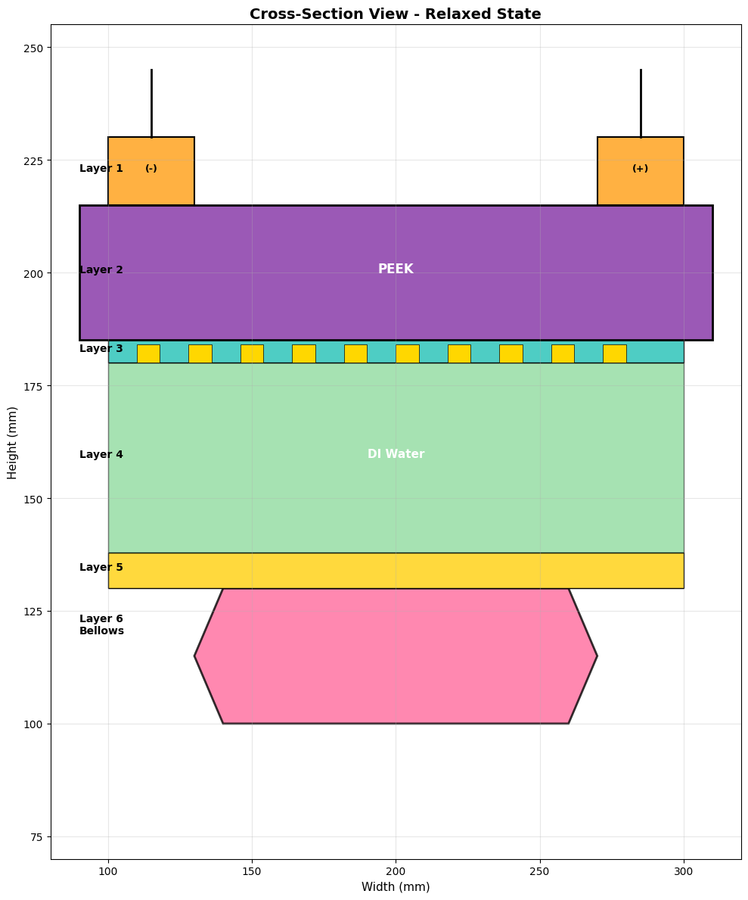
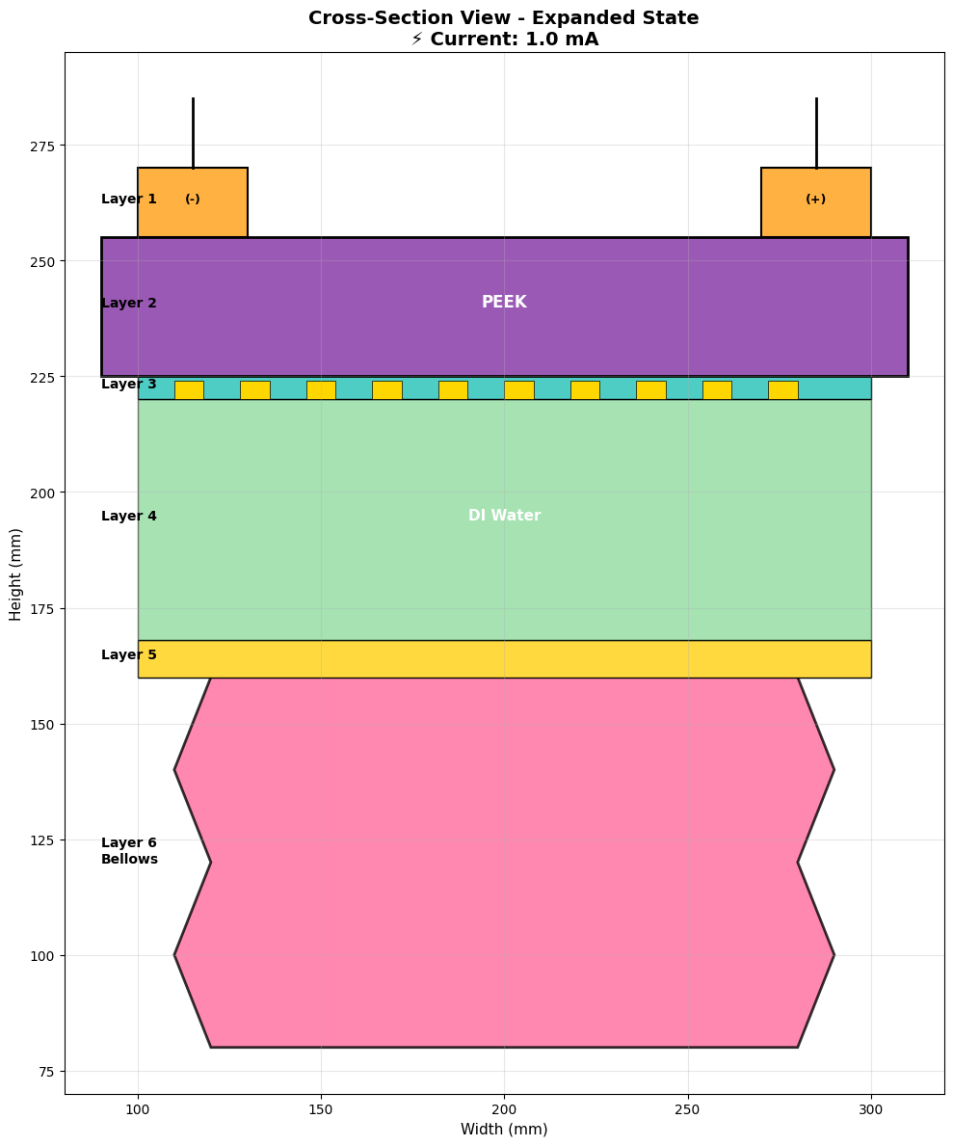
Device - Layer Structure (Cross-Section View)

Slide 8
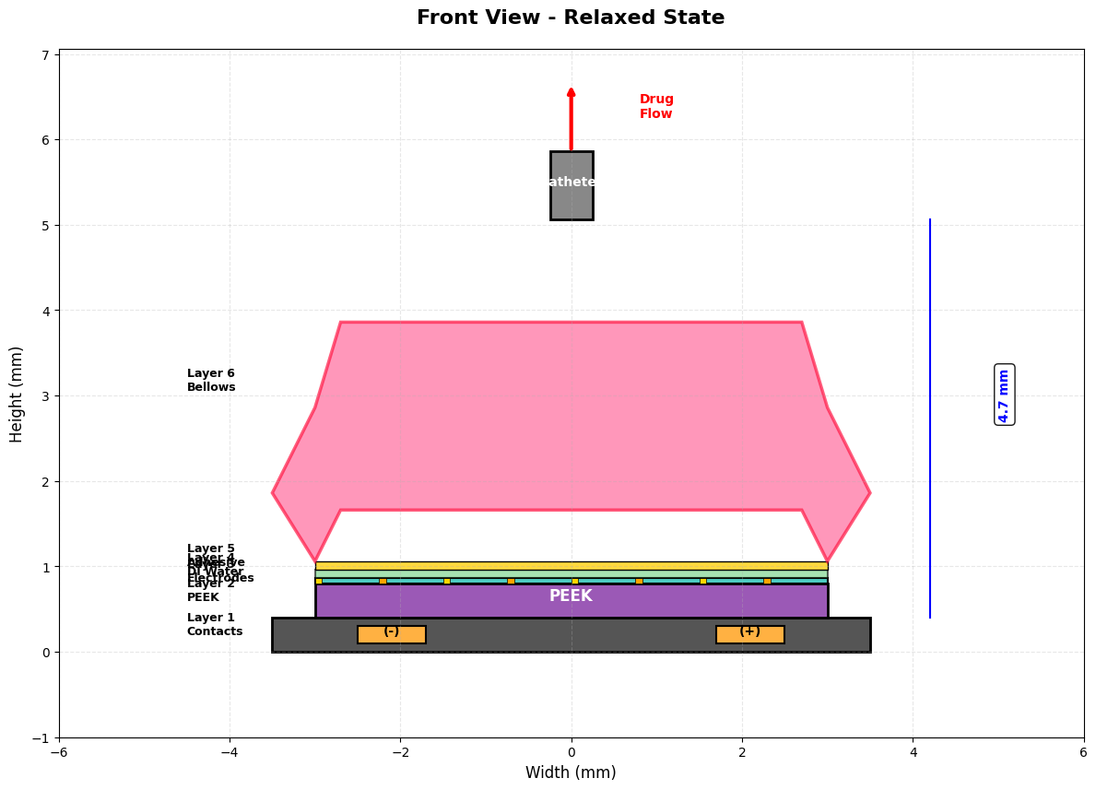
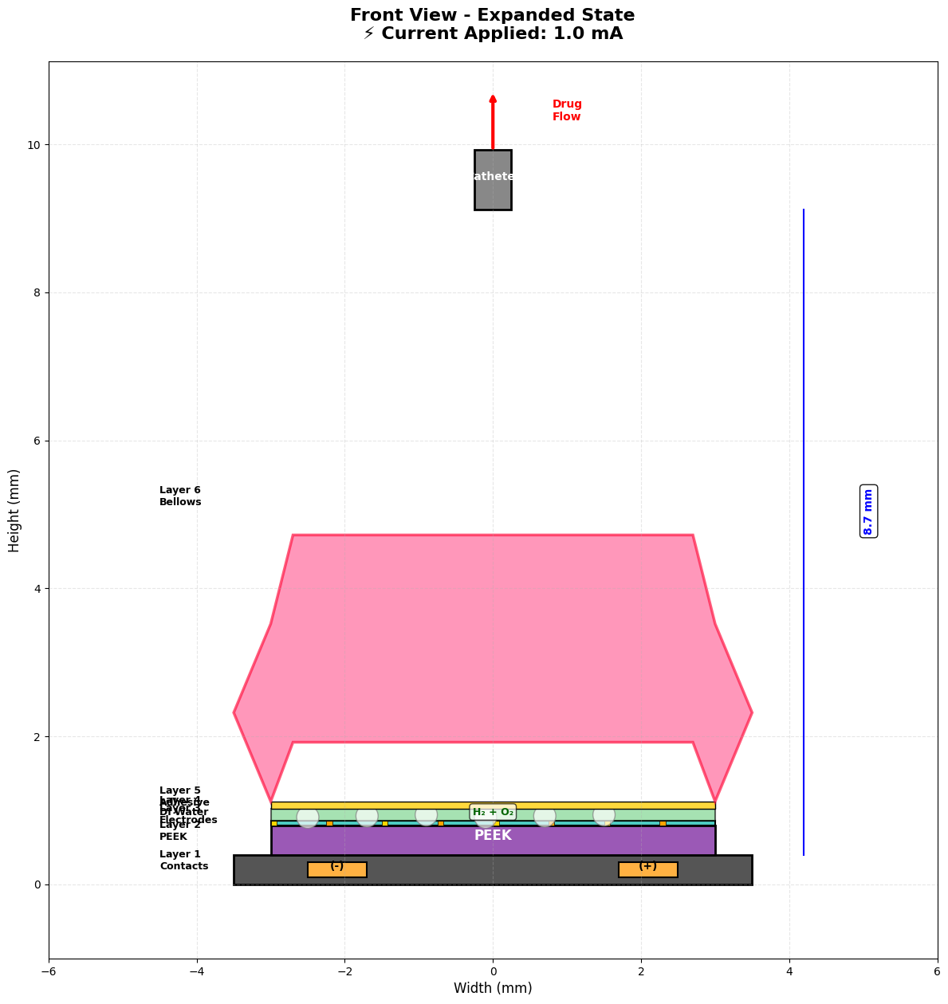
Device - Layer Structure (Front View)

Slide 9
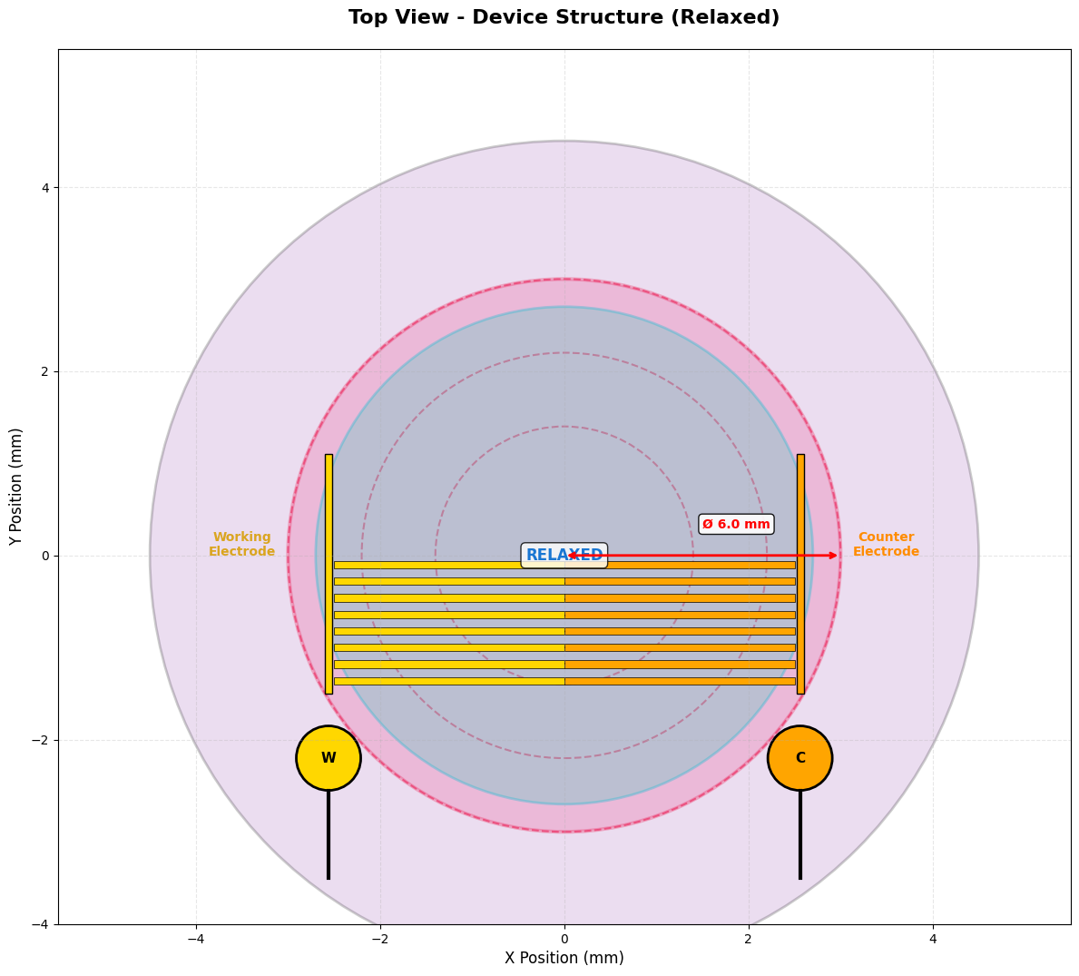
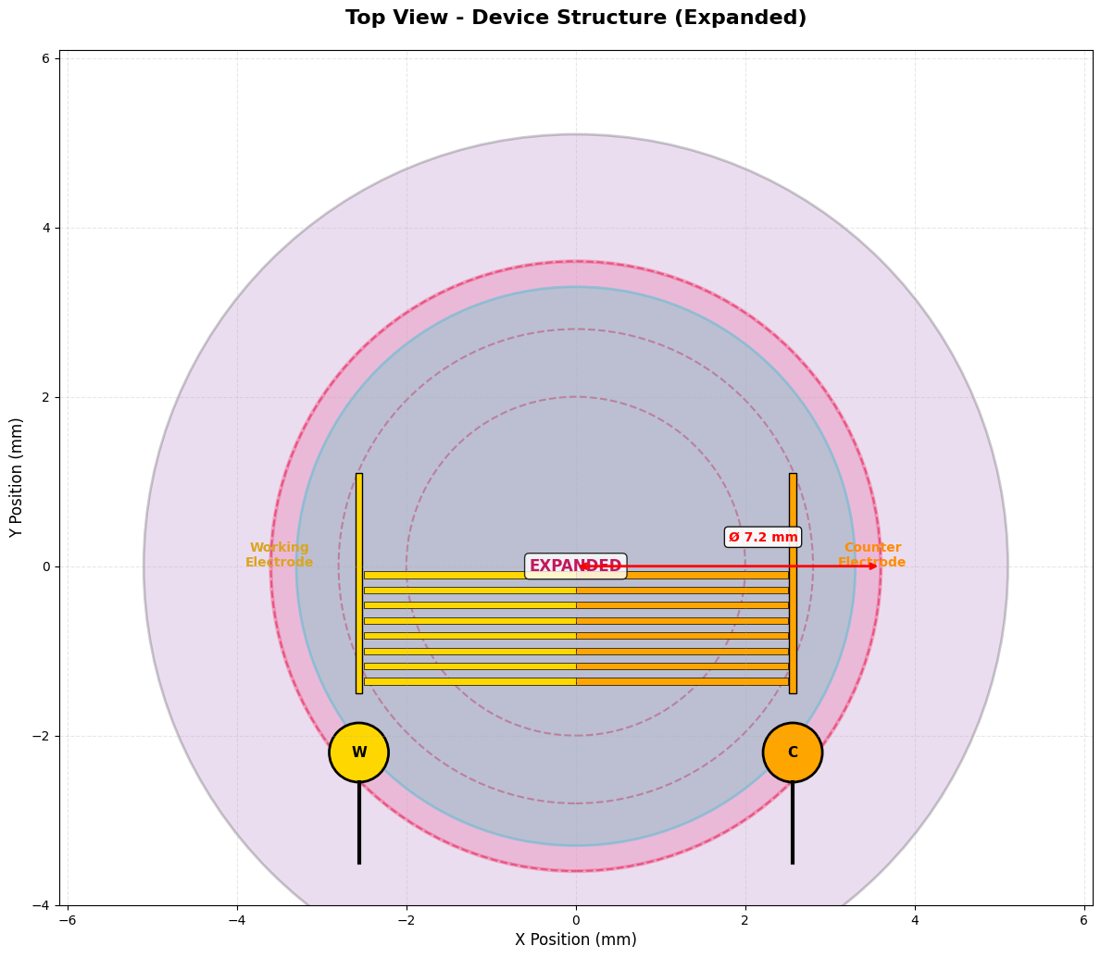
Device - Layer Structure (Top View)

Slide 10
Operating Principle - Electrolysis Actuation
Step 1: Current Applied (1.0 mA)
DC current flows through Pt/Ti interdigitated electrodes immersed in DI water
Step 2: Water Electrolysis
2H₂O(l) → 2H₂(g) + O₂(g)
Hydrogen and oxygen gases generated at cathode and anode
Step 3: Pressure Buildup
Gas accumulation increases pressure inside sealed bellows chamber
P = nRT/V
Step 4: Bellows Expansion
Pressure forces Parylene bellows to expand vertically (4 mm → 8 mm)
Step 5: Drug Expulsion
Bellows compression displaces drug from reservoir through check valve and catheter to tumor
Step 6: Gas Recombination (OFF)
When current stops, H₂ and O₂ recombine back to water on Pt catalyst surface
2H₂(g) + O₂(g) → 2H₂O(l)
Bellows relaxes, ready for next cycle

Slide 11
Modeling – Simulation based
1. Electrolysis Gas Generation Model
Faraday's Law of Electrolysis:
n = (I × t) / (z × F)
Where: n = moles of gas, I = current (A), t = time (s), z = 2.67 electrons/molecule, F = 96,485 C/mol
Molar Generation Rate:
dn/dt = I / (z × F) = I / 257,615
2. Gas Volume and Pressure Model
Ideal Gas Law:
PV = nRT → V = nRT/P
Where: R = 8.314 J/(mol·K), T = 310 K (body temp), P = 101,325 Pa
Volumetric Generation Rate:
dV/dt = (dn/dt × R × T) / P = 7.87 × 10⁻¹¹ m³/s = 4.72 μL/min at 1.0 mA
3. Flow Rate Model
Poiseuille's Equation for Catheter Flow:
Q = (π r⁴ ΔP) / (8 η L)
Where: r = catheter radius, ΔP = pressure difference, η = viscosity, L = catheter length
Simplified Model:
Q = P_net / R_hydro
Where: P_net = Bellows pressure - Tissue backpressure and R_hydro = Hydraulic resistance (catheter geometry dependent)

Slide 12
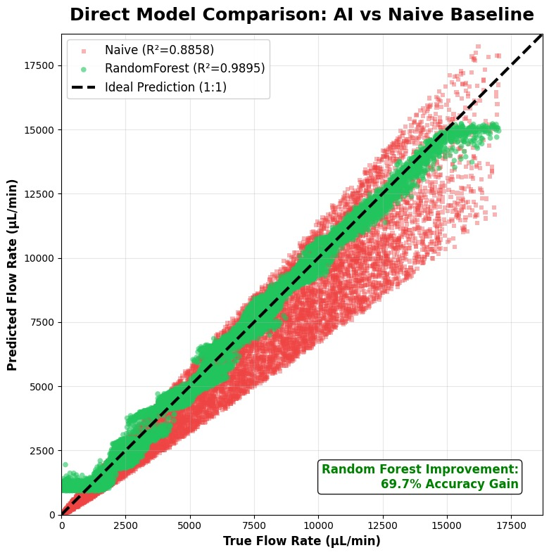
Model used
Model Architecture
Random Forest ensemble with 100 decision trees trained on 50,000 synthetic physiological samples
Performs 3-sensor fusion combining hot-film voltage, RTD temperature, and thermal transient rate to predict true flow rate
Accuracy Results
Random Forest achieves R² score about 0.98 indicating near-accurate prediction correlation where the naïve version gives nearly 0.88
Overall accuracy improvement of 60–80% over traditional physics-only approach

Slide 13
Input/Output Response Characterization
Input Parameters
Applied current ranges from 0.5–2.0 mA DC driving the electrolysis-based bellows pump for precise flow control
Operating voltage maintained at 3–5 V enabling low-power implantable operation
Digital ON/OFF control signal allows programmable dosing schedules and therapeutic protocols
Drug reservoir capacity of 100–300 μL provides sufficient volume for extended treatment periods
Refill schedule of every 2–4 weeks minimizes patient intervention while ensuring continuous therapy
Output Performance
Flow rate spans 1–34 μL/min with direct current-dependent modulation for precise dosing
Drug volume delivered is fully programmable based on therapeutic requirements and patient response
Delivery duration flexibly ranges from minutes to hours supporting both bolus and sustained release profiles
Local drug concentration achieves 10–100× higher levels at target site compared to systemic delivery
Systemic drug exposure reduced by approximately 90% minimizing off-target side effects and toxicity
Clinical Advantage
Combination of precise input control and targeted output delivery enables personalized therapy with maximum efficacy and minimum systemic burden

Slide 14
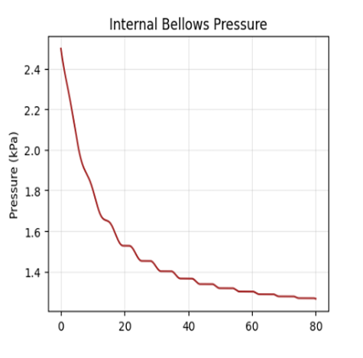
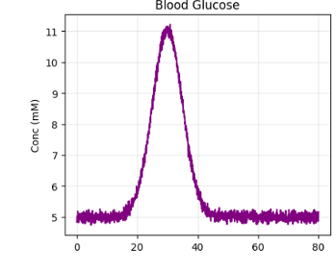
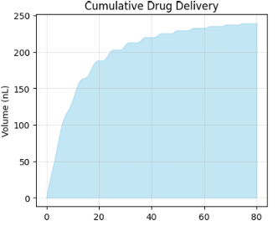
Output plot visualizations
Internal Pressure
Bellows pressure starts at ~2.5 kPa and decreases rapidly during initial drug release phase
Pressure stabilizes around 1.3 kPa after t=40s as reservoir depletes and system reaches equilibrium
Sharp initial drop indicates active electrolysis-driven pumping responding to high glucose levels
Glucose Concentration (Middle Plot)
Blood glucose begins at critical high level (~120 mM) simulating hyperglycemic condition
Exponential decay pattern shows effective glucose reduction through insulin delivery
Reaches stable baseline (~5-10 mM) by t=30-40s indicating successful glycemic control
Cumulative Drug Delivery (Right Plot)
Steepest delivery rate occurs during first 30 seconds when glucose levels are highest
Delivery rate slows after t=40s as glucose normalizes and target flow rate decreases
Stepped pattern reflects closed-loop control adjusting delivery based on real-time glucose feedback

Slide 15
Packaging Plans - Biocompatible Encapsulation
Packaging Layer 1: Parylene C Conformal Coating
Thickness: 5-10 μm deposited via CVD
Coverage: All electronics and connections
Function:
Moisture barrier (water absorption < 0.1%)
Electrical insulation
Pinhole-free conformal coating
USP Class VI biocompatible
Masking: Protect refill port and catheter outlet during deposition
Packaging Layer 2: Silicone Rubber Overmolding
Material: Medical-grade silicone (NuSil MED-6015 or equivalent)
Process:
Create overmold with rounded contours
Position device in mold
Pour silicone, degas
Cure at 150°C for 1 hour
Demold and inspect
Features:
Smooth external surface (tissue compatibility)
Mechanically robust protection
Integrated refill port septum (self-sealing)
Wireless coil embedded in silicone
Refill Port Design
Type: Self-sealing silicone septum (2-3 mm diameter)
Capability: > 100 percutaneous refills with 25-30 G needle
Access: Transcutaneous through skin
Procedure: Outpatient, no anesthesia required, < 5 minutes

Slide 16
Plans for Clinical Use
Surgical Implantation
Procedure
Minimally invasive surgery
Local or general anesthesia
Subcutaneous pocket creation
Device placement near tumor
Catheter insertion to tumor core
Image-guided positioning (CT/ultrasound)
Recovery
Outpatient or overnight observation
Wound healing: 7-10 days
Minimal scarring (small incision)
Return to normal activity: 1-2 weeks
Drug Loading & Programming
Initial Drug Loading
Fill reservoir with siRNA-gold nanorod complexes (nanoplexes) or chemotherapy drug
Volume: 200 μL typical initial dose
Concentration: Optimized for application
Dosing Schedule Programming
Via wireless interface: Computer or smartphone app
Flow rate: Set target current (0.5-2.0 mA)
ON duration: Minutes to hours per session
OFF duration: Rest periods between doses
Daily schedule: Programmable start times
Total delivery volume: Track cumulative dose

Slide 17
Thank You!

